Slide 1
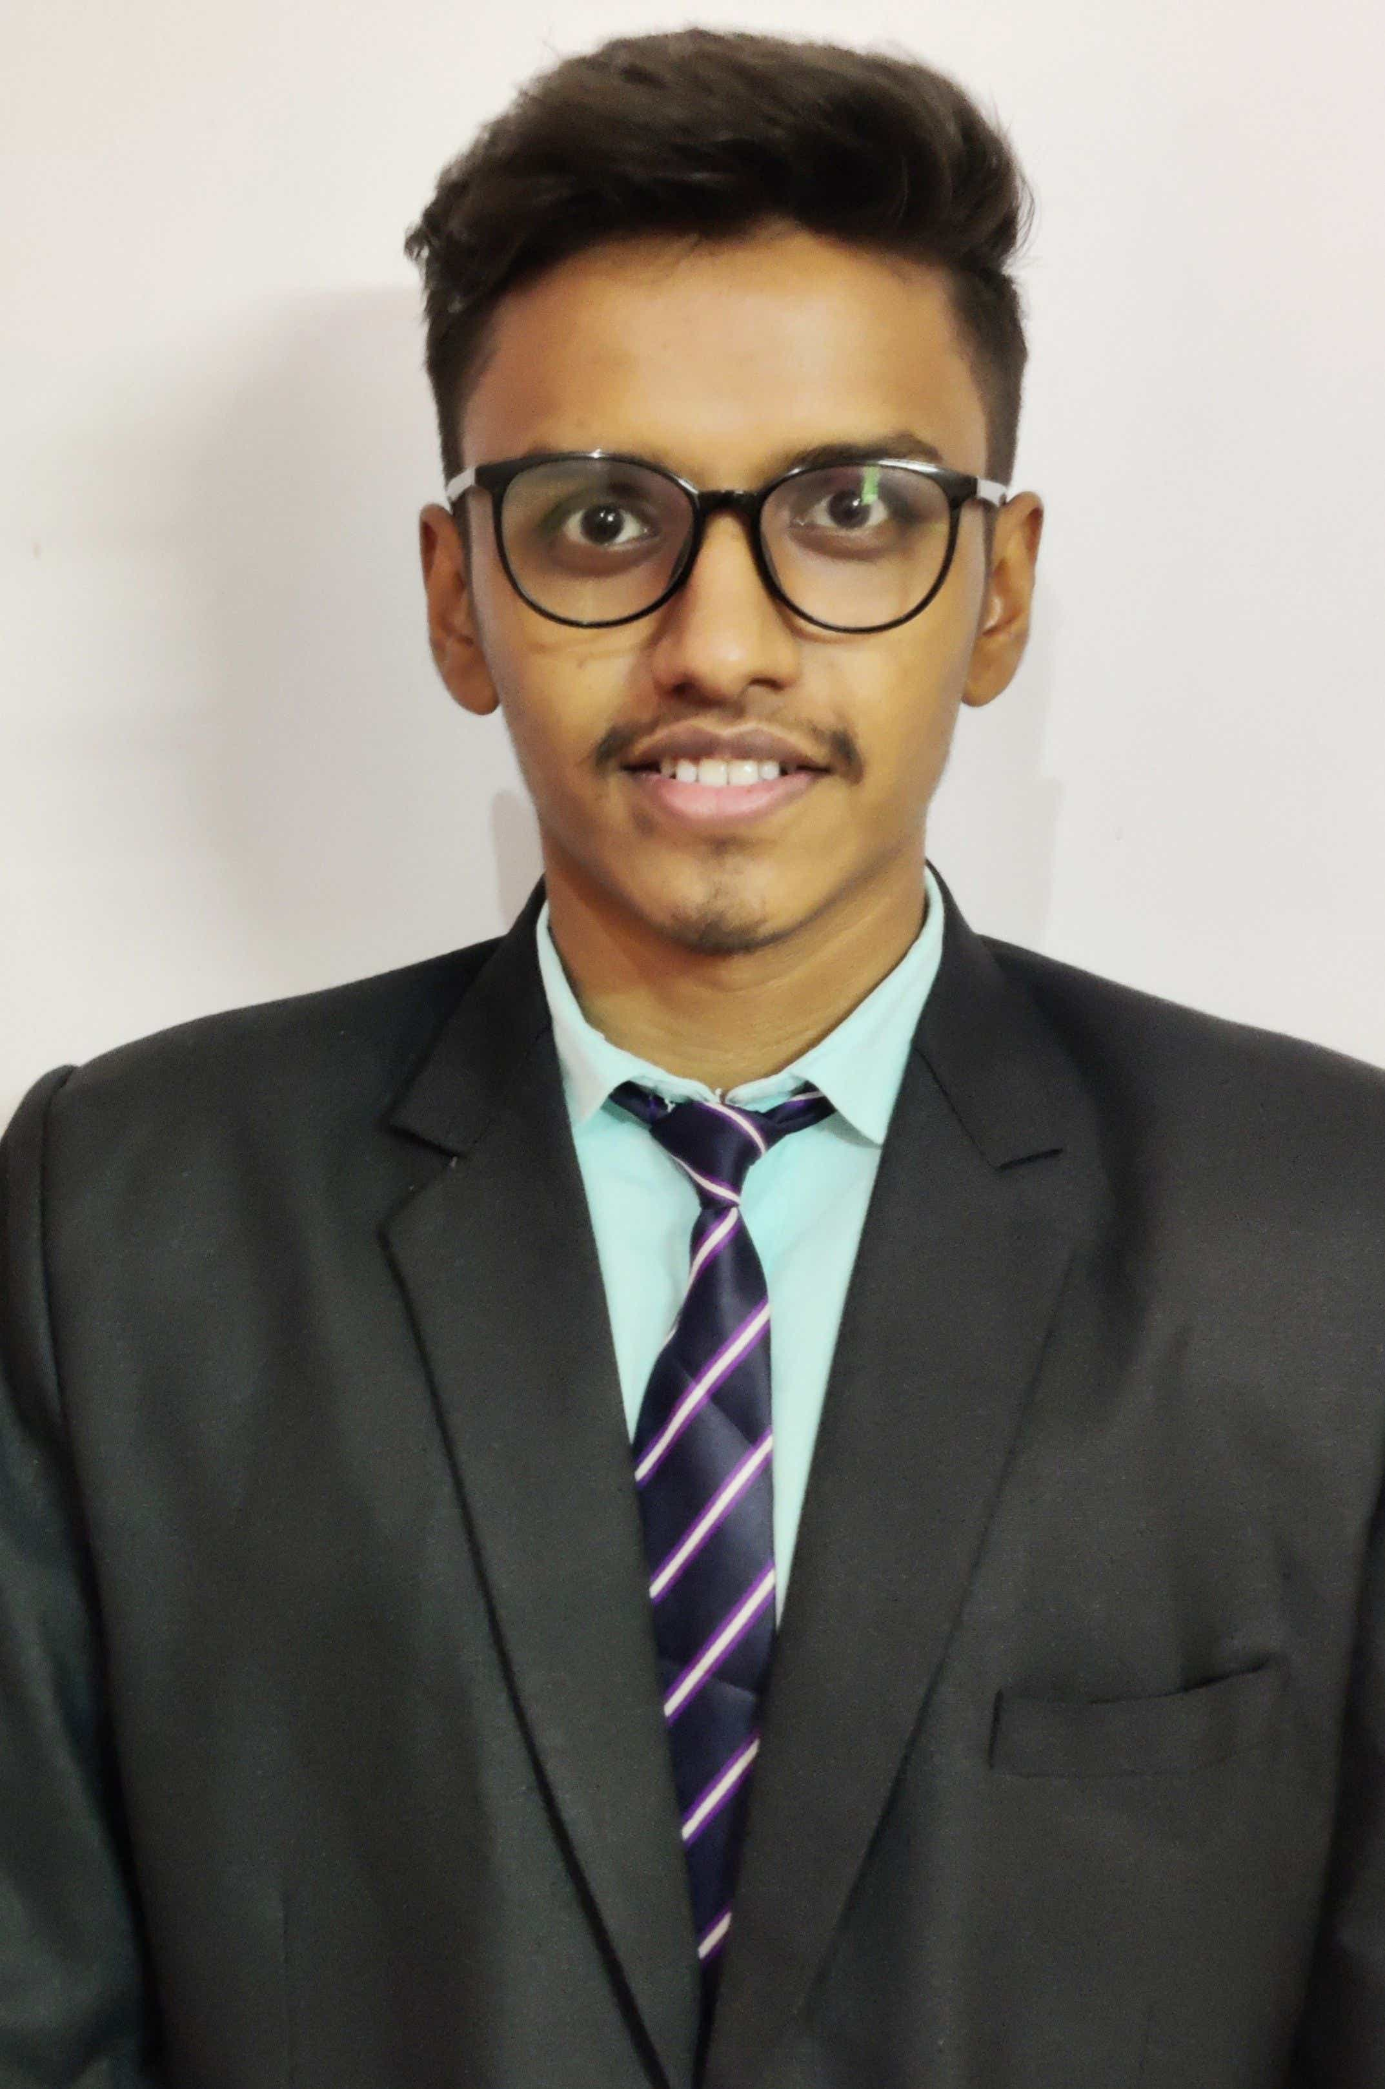



Atharva Mehendre
Analyst/Software Engineer
Bachelor of Engineering
Computer Science : 2018 - 2022
Skills
Mumbai
Java 8 /J2EE | Java Basics, OOPS, Generics, Collections, Arrays, Loops, Lambda Exp, Stream API Junit, Mockito, Servlets
Spring core | IOC & Dependency Injection, Autowire
Spring REST | REST controllers, Implementation of GET, POST, PUT & DELETE, Bean Validation & Exception Handling, Testing Services, Controller & Repository layer
Spring Data JPA | Implement DAO layer using spring Data repositories.
Spring Boot Microservices | Spring Boot Starters, annotations, Messaging Service, Sync/Async comms, Swagger API specifications
Spring Cloud | Eureka, Netflix Ribbon, Hystrix, Zuul & Config Server
Angular | Components, Services, Modules, Routing, Forms & Validation
Database | MySQL, MongoDB basics
UI Tech | HTML 5 & CSS 3, JavaScript & TypeScript Reusable templates, Optimized UI Designed
Tools | Git, Postman, Maven, IDE.
Devops | CI/CD, Jenkins configuration, notifications, quality gate understanding
Add On skills | Communications, Team management. Peer learning.
atharva-nandkumar.mehendre@capgemini.com
+91 7447479199
A4
E-Commerce Shopping Cart Application
Completed end to end case study of Shopping Cart Application along with JWT authentication, Swagger and payment testing. Material-UI and Angular, Bootstrap used for user interface.
Hospital Management System
Developed Online Hospital Management System Using spring microservices and AngularJs with MYSQl as database.
HTML CSS JAVASCRIPT for web developers at Coursera.
Completed ”Java Programming masterclass - by Tim Buchalka“ course at Udemy
Full Stack developer
Hands on experience in creating Microservices with SpringBoot , Spring security, Spring Cloud, API Gateway, Eureka Server.
Proficient in creating Single page Web Application in Angular with Routes, Bootstrap CSS, HTML5, Components , Reactive forms and Authentication.​
Experience in creating documentation with Swagger, messaging service using RabbitMQ and SMTP for Email Service and SMS Service.​
Used TDD based development using tools like Mockito, Junit and ensuring quality.
Understanding of AWS Cloud environment​
Check out my work on GitHub & Video Profile

